Slide 1

DOMAIN 3in ISC2
(access control concepts)
BY
EZEKWE KING DAVID NNAEMEKA

Slide 2
scope
Overview of security controls, including security control concepts, defense in depth, and privileged account access management.
Separation of duties, covering two-person integrity, authorized versus unauthorized accounts, user provisioning processes, and separation of employment.
Physical security controls, including types of physical access control, badge systems, CPTED, biometric controls, monitoring, security guards, and alarm systems.
Logical access control.
Access control models,DAC,MAC, RBAC and RuBAC.
Conclusion and Q&A.

Slide 3
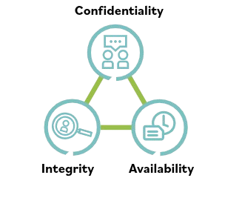
Introduction of security control
Security control:

Slide 4
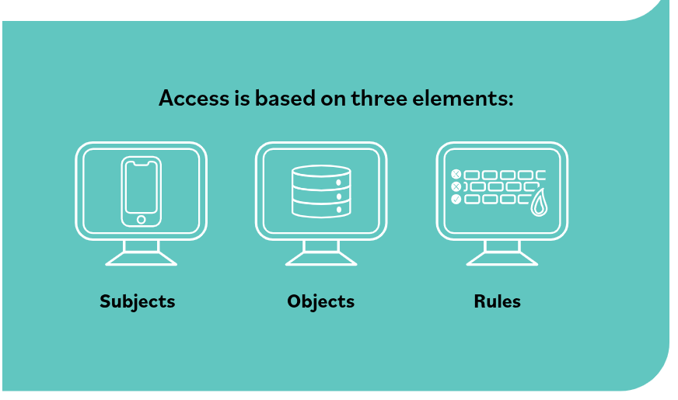
ACCESS CONTROL OVERVIEW

Slide 5
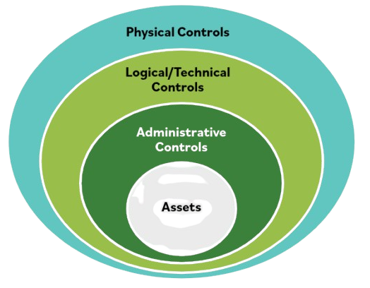
DEFENSE IN DEPTH

Slide 6
PRIVILEGED ACCOUNT ACCESS MANAGEMENT
TYPES OF PRIVILEGED ACCOUNT
System Administrator.
Help Desk or IT support.
Security analyst.

Slide 7
SEPARATION OF DUTIES
Two person integrity
Authorized versus unauthorised personnel

